Slide 1

QBUS3350: Project Planning and Management
Project Selection
Taught by
Dr. Erick Li
Discipline of Business Analytics

Slide 2
Chapter 3: Learning Objectives
After completing this chapter, students will be able to:
Explain six criteria for a useful project selection/screening model.
Understand how to employ checklists and simple scoring models to select projects.
Use more sophisticated scoring models, such as the Analytical Hierarchy Process.
Learn how to use financial concepts, such as the efficient frontier and risk/return models.

Slide 3
Chapter 3: Learning Objectives
After completing this chapter, students will be able to:
Employ financial analyses and options analysis to evaluate the potential for new project investments.
Recognize the challenges that arise in maintaining an optimal project portfolio for an organization.
Understand the three keys to successful project portfolio management.

Slide 4
PMBOK Core Concepts
Project Management Body of Knowledge (PMBoK) covered in this chapter includes:
Portfolio Management (PMBoK 1.4.2)

Slide 5
Project Selection
Screening models help managers pick winners from a pool of projects. Screening models are numeric or nonnumeric and should have:
Realism
Capability
Flexibility
Ease of use
Cost effectiveness
Comparability
Notes:
Chapter Learning Objective 1.
Realism: An effective screening models should reflect organizational objectives and be capable of picking “winners” from a large set of potential projects.
Capability: Flexible enough to respond to changes in conditions under which projects are carried out. Can be used in a wide range of project types.
Flexibility: Can be easily modified if trial applications require changes. (To adapt to changes in tax laws, and so forth.)
Ease of use: Simple enough to be used by people in all areas of the organization. (100 input parameters vs 5 input parameters)
Cost: Inexpensive to use (e.g., require less data input).
Comparability: Broad enough to be applied into multiple projects. If the screening model is too narrowly focused, it may be bias toward some projects.

Slide 6
Screening & Selection Issues
Risk – unpredictability to the firm
Technical
Financial
Safety
Quality
Legal exposure
Commercial – market potential
Expected return on investment
Payback period
Potential market share
Long-term market dominance
Initial cash outlay
Ability to generate future business/new markets
Notes:
The number of factors that can be considered when evaluating project alternatives can be enormous. Table 3.1 (page 6-7 of slides) gives you a partial list of the factors.

Slide 7
Screening & Selection Issues
Internal operating – changes in firm operations
Need to develop/train employees
Change in workforce size or composition
Change in physical environment
Change in manufacturing or service operations
Additional
Patent protection
Impact on company’s image
Strategic fit
All models only partially reflect reality and have both objective and subjective factors imbedded.

Slide 8
Approaches to Project Screening
Checklist model
Simplified scoring models
Analytic hierarchy process
Profile models

Slide 9
Checklist Model
A checklist is a list of criteria applied to possible projects.
Requires agreement on criteria
Assumes all criteria are equally important
Checklists are valuable for recording opinions and stimulating discussion.
Adv: It is simple and easy to use as no weight and criteria needed to be assigned; it is user friendly so that everyone can use the method.
Disadv: it might be unrealistic that all criteria are equally important in the reality; the weighting system is very important in establishing trade-off between different criteria

Slide 10
Simplified Scoring Models
Each project receives a score that is the weighted sum of its grade on a list of criteria. Scoring models require:
agreement on criteria
agreement on weights for criteria
a score assigned for each criteria
Relative scores can be misleading!

Slide 11
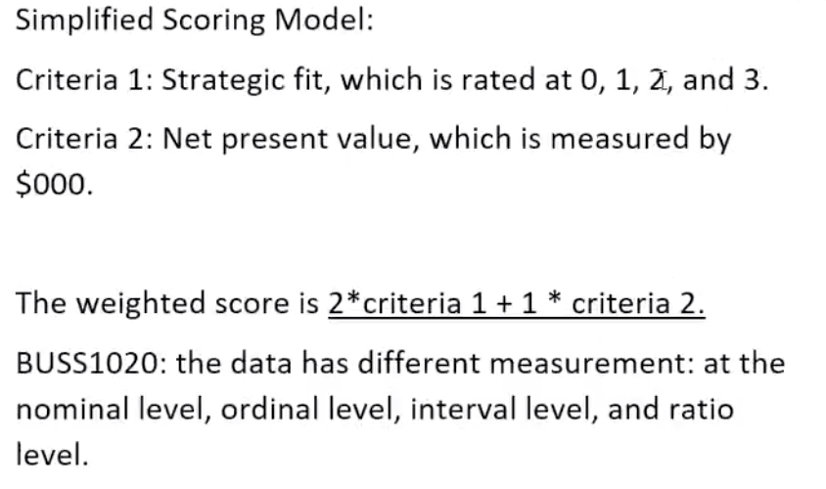
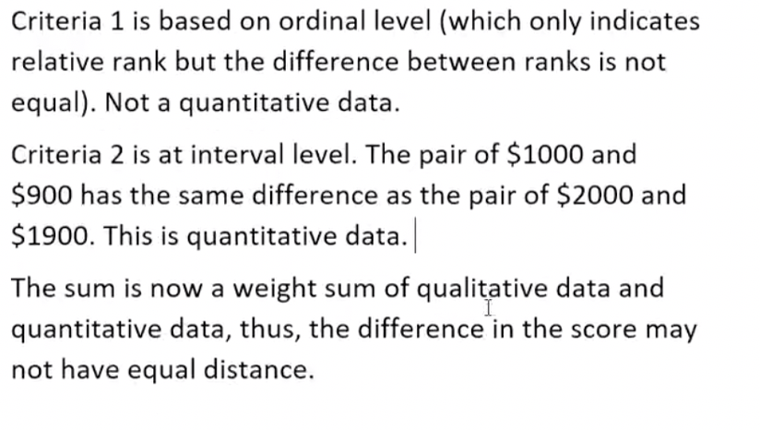
Why relative scores can be misleading? Because the difference in the score may not have equal distance
Example:

Slide 12
Analytic Hierarchy Process
The AHP is a four step process:
Construct a hierarchy of criteria and subcriteria.
Allocate weights to criteria.
Assign numerical values to evaluation dimensions.
Determine scores by summing the products of numeric evaluations and weights.
Unlike the simple scoring model, these scores can be compared!
Definition: AHP allows weighting by main and sub criteria, this eliminates the double accounting of the grading model. Finally, AHP creates results that are easily comparable between projects as well as within cost and benefit analysis.

Slide 13
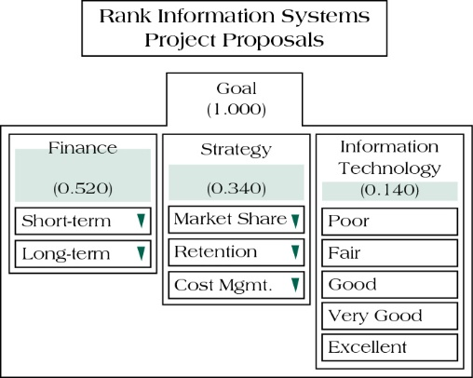
Sample AHP with Rankings for Salient Selection Criteria (Figure 3.1)
Notes:
AHP process mitigates the double counting problem in simple scoring models, where criteria such as service, quality, and customer satisfaction could be overlapping factors. Sometimes, too little or too much weight may be assigned to a given criterion. With AHP, these factors are grouped as subcriteria and share the weight of a common higher-level criterion. For instance, short-term and long-term are split into 30-70. Then short-term financial goal is assigned with a weight of 0.52*0.3=0.156.
Total weight on strategy is 0.34, among which, 24% goes to cost management, 46% goes to retention, and 30% goes to market share.

Slide 14
Sample AHP with Rankings for Salient Selection Criteria (Figure 3.3)
Rating
Poor (0) | Fair (0.1) | Good (0.3) | Very Good (0.6) | Excellent (1)
 |  | Finance(0.52) |  | Strategy(0.34) |  |  |  | Information (0.14)
 |  | =0.3*0.52 | =0.7*0.52 | =0.34*0.24 | =0.34*0.36 |  | =0.34*0.24
 |  | 0.156 | 0.364 | 0.102 | 0.1564 |  | 0.0816 | 0.14
 | Alternatives | Short term | Long term | Market Share | Retention |  | Cost Mgt | Technology | Total
1 | Perfect | Excellent (1) | Excellent | Excellent | Excellent |  | Excellent | Excellent | 1
2 | Aligned | Good(0.3) | Excellent | Good | Excellent |  | Good | Excellent | 0.762
3 | Not Aligned | Excellent(1) | Good | Excellent | Good |  | Excellent | Good | 0.538
4 | All Very Good | Very Good(0.6) | Very Good | Very Good | Very Good |  | Very Good | Very Good | 0.6
5 | Mixed | Poor(0) | Fiar | Good | Very Good |  | Excellent | Good | 0.284
Notes:
The perfect project receives a score of 1 (based on project 1).
The aligned project receives a score of 0.156*0.3+0.364*1+0.102*0.3+0.1564*1+0.0816*0.3+0.14*1=0.762 (based on project 2)
The weight on Strategy is 0.34. Cost management 0.24*0.34=0.0816, Retention 0.46*0.34=0.1564, and Market Share 0.3*0.34=0.102.

Slide 15
Analytic Hierarchy Process
Limitations of AHP include:
The AHP model does not adequately account for “negative utility” (e.g. negative cash outflow).
Counter measure: Use AHP score divided by the investment cost.
All criteria must be fully disclosed and accounted for at the beginning of the selection process.
Powerful members can influence the process of assigning weights and determining criteria.

Slide 16
Profile Models (figure 3.4)
X₇
X₆
Maximum
Desired Risk
X₂
Risk
X₄
X₅
Efficient Frontier
X₃
X₁
Minimum
Desired Return
Return
Notes:
X3 dominates X2 because they yield the same return but X3 imposes a lower risk.
X7 is outside of the maximum risk that is allowed.
X5 dominates X4.
Connecting all the projects that are not dominated by any other, we obtain the efficient frontier. The optimal project to be chosen must be on this frontier.

Slide 17
Financial Models
Payback period
Net present value
Discounted payback period
Internal rate of return

Slide 18
Payback Period
Determines how long it takes for a project to reach a breakeven point
Cash flows should be discounted.
Lower numbers are better (faster payback).
Assumption: the cash flow in a year will be evenly occurs within the calendar year

Slide 19
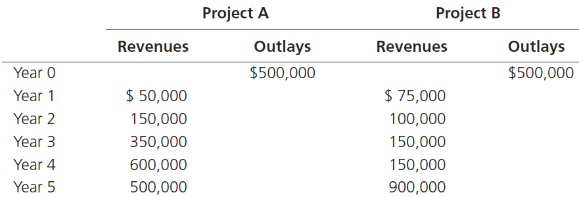
Payback period example (table 3.5)

Slide 20
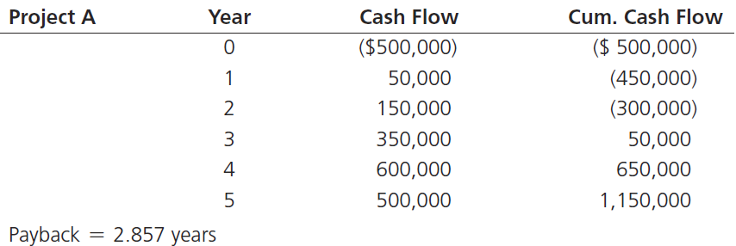
Payback Period Example (table 3.6)
Divide the cumulative amount by the cash flow amount in the third year and subtract from 3 to find out the moment the project breaks even.
3 - 50,000 = 2.857
350,000

Slide 21
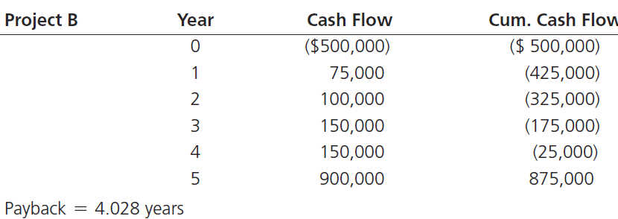
Payback Period Example (table 3.6)
Divide the cumulative amount by the cash flow amount in the third year and subtract from 3 to find out the moment the project breaks even.
5 – 875,000 = 4.028
900,000

Slide 22
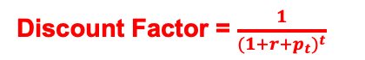
Net Present Value – the larger the better
Discount Factor = $\frac{1}{{(1+r+p_{t})}^{t}}$
Projects the change in the firm’s stock value if a project is undertaken.
Higher NPV values are better!
r is often determined by the cost of capital.
The inflation rate (which is based on forecasts) can be time-dependent.
The length of each period is chosen by convenience (e.g., month, quarter, half-year, year, and so forth).
Period 0 must be the start of the project.
Ft is based on forecast and needs to consider the tax effect.
Discount rate = r+p

Slide 23
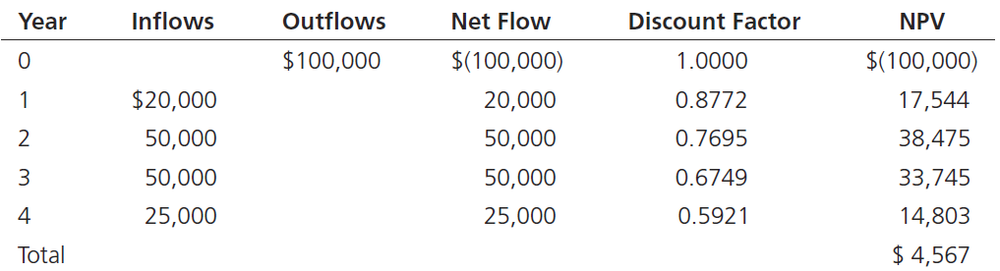
Net Present Value Example (Table 3.8)
EXCEL syntax for NPV
=Initial investment + NPV(Discount Rate, Cells of cash flows)
Required rate of return is 10%, inflation rate is 4%.

Slide 24
Net Present Value
What if some of the candidate projects do not have equal durations?
Find T, which represents the minimum common multipliers of all projects’ duration.
For each candidate project, k= (T/project duration).
Repeat each project k times over T periods.
Use cash flows over T periods to determine NPV.
Choose the project that has the highest NPV.
See examples in tutorials.

Slide 25
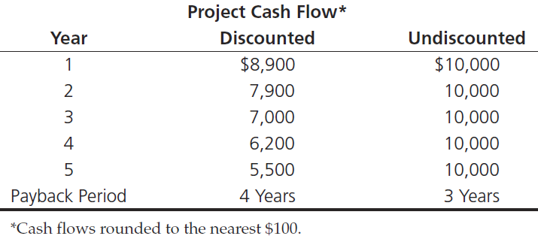
Discounted payback period (table 3.9)
Initial investment is $30,000

Slide 26
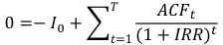
Internal Rate of Return
A project must meet a minimum rate of return before it is worthy of consideration.
Higher IRR values are better!
Assume the inflation rate is zero. IRR is the required rate of return such that project NPV equals zero.
$$0=−I_{0}+\sum_{t=1}^{T}{\frac{{ACF}_{t}}{{(1+IRR)}^{t}}}$$
where I₀ is the initial cash outflow at period 0, ACF_{t} is the annual cash flow after tax at period t, and IRR is the internal rate of return.

Slide 27
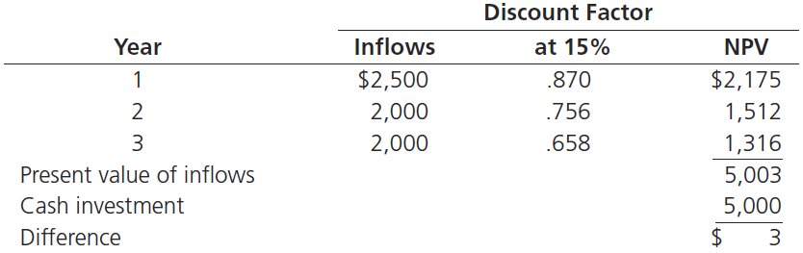
Internal Rate of Return Example
This table has been calculated using a discount rate of 15%.
The project does meet our 15% requirement and should be considered further.

Slide 28
Using EXCEL
NPV =Initial investment + NPV(Discount rate, Cells of future cash flows)
IRR = IRR(Cells of all cash flows, including initial investment)
Actually, you can use SOLVER to find IRR.
Why do we prefer IRR to NPV? Use the data of Question 3.5 to 3.6.
We prefer IRR to NPV when projects have different duration, we don’t need to change the duration of two projects to be the same.

Slide 29
Project Portfolio Management
The systematic process of selecting, supporting, and managing the firm’s collection of projects.
Portfolio management objectives and initiatives require:
decision making
prioritization
review
realignment – needed due to external changes
reprioritization of a firm’s projects – needed due to external changes

Slide 30
Portfolio Management System
How to design a project portfolio system:
Classification of a project
Selection criteria depending upon classification
Sources of proposals
Evaluating proposals
Managing the portfolio of projects.

Slide 31
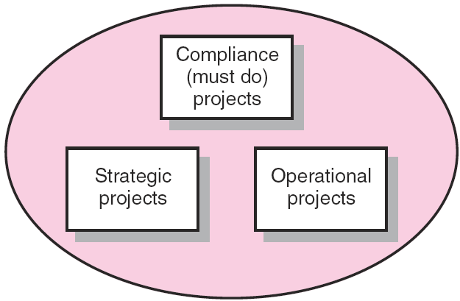
Portfolio of Projects by Type
Compliance projects are those needed to meet regulatory conditions.
- Compliance with no under-aged workers.
- Re-building a soybean factory destroyed by fire.
Operational projects are those needed to support current operations.
Sustainability projects
Strategic projects are those supporting the organisation’s long-run missions.
- R&D

Slide 32
Selection criteria
For compliance projects
Compliance (safety, quality, and so forth), cost, time
For operational projects,
Performance, time, cost, user satisfaction
For strategic projects,
Market share, new opportunities, new technologies, and so forth

Slide 33
Keys to Successful Project Portfolio Management
Flexible structure and freedom of communication
Low-cost environmental scanning
Time-paced transition

Slide 34
Problems in Implementing Portfolio Management
Conservative technical communities
Out-of-sync projects and portfolios
Unpromising projects
Scarce resources

Slide 35
Using Linear Programming (LP) Model to Maximize Benefits
Index | Project | Cost in 2010 | Cost in 2011 | Cost in 2012 | Cost in 2013 | Cost in 2014 | Benefits | Dependency
1 | Downtown | 2 | 2 | 3 | 3 | 3 | 50 | With 4
2 | Housing | 10 | 10 | 10 | 10 | 10 | 80
3 | Flood | 20 | 20 | 10 |  |  | 85 | Not with 7
4 | Street |  |  | 8 | 8 | 8 | 60 | With 1
5 | Wireless | 10 | 15 |  |  |  | 75
6 | Library | 0.5 |  | 0.5 |  | 0.5 | 25
7 | Water |  | 20 |  | 20 |  | 50 | Not with 3
8 | Waste |  | 2.5 | 2.5 |  | 2.5 | 35
9 | Facilities | 15 |  | 17 |  | 20 | 65
10 | Parking | 18 | 20 |  | 17 |  | 60 | Only if 9 is picked
 | Available Annual Budget | 30 | 30 | 30 | 35 | 35

Slide 36
Maximizing The Benefit of Your Portfolio
Objective:
Constraints:
Decision variables {u_{i}} are binary: when it equals 1, project i is chosen; otherwise, project i is not chosen.
Dependency constraints.
u₁=u₄;
u₃+u₇≤1;
u₁₀≤u₉;

Slide 37
Maximizing The Benefit of Your Portfolio
Annual budgets
For 2010, 2u₁+10u₂+20u₃+10u₅+0.5u₆+15u₉+18u₁₀≤30
For 2011, 2u₁+10u₂+20u₃+15u₅+20u₇+2.5u₈+20u₁₀≤30
For 2012, …
For 2013,
For 2014,

Slide 38
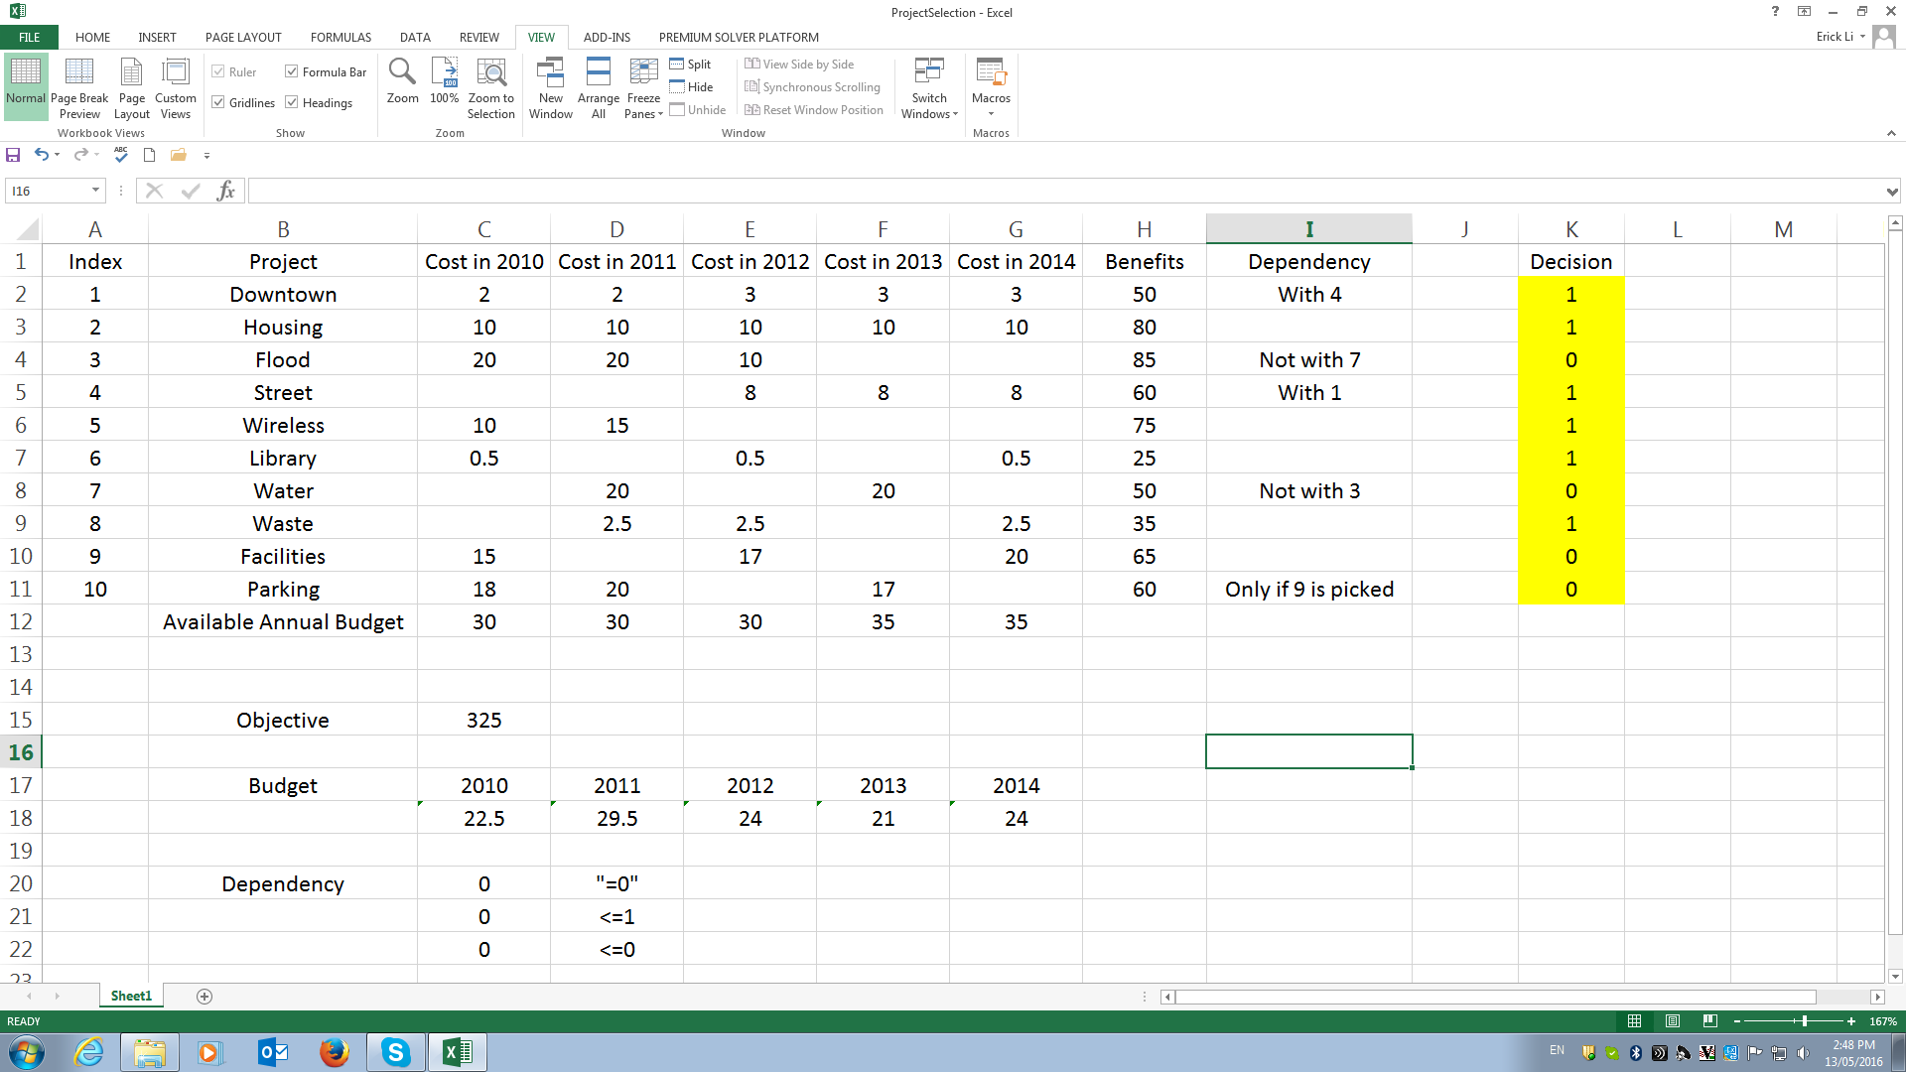
Maximizing The Benefit of Your Portfolio
Use EXCEL SOLVER

Slide 39
Challenges in Project Selection
Information asymmetry and conflicting interests give rise to moral hazard (i.e., hidden action) and adverse selection (i.e., hidden information).
A large body of economics, finance, and accounting literature has been devoted to studying the impact of information asymmetry on project selection and project management.

Slide 40
Challenges in Project Selection
To illustrate, consider a simple example as follows.
The subsidiary has two projects to propose. Each project generates a subsidiary project X and a headquarters’ profit Y. The consolidated profit is then X+Y.
Suppose that the Headquarters does not observe the attributes of the available projects. Due to limited capital, only one project can be undertaken. The subsidiary can pretend that project B is the only available project. The lost consolidated profit equals 26-18=8.
Project ID | Subsidiary Profit X | Headquarters’ Profit Y
A | 10 | 16
B | 15 | 3
Notes:
New rule: Each proposed project must generate at least 5 units of profit to the headquarters. Under this rule, the subsidiary canot propose project B.

Slide 41
Challenges in Project Selection
A thought-provoking question is that “how do companies design a project selection system to mitigate the inefficiency caused by information asymmetry?”
The current research mainly considers:
Incentives when cash transfer is permitted.
Example: Link the reward to subsidiary to the consolidated profit rather than the subsidiary profit. How? Use shares.
Appropriate selection standard when cash transfer is not permitted or infeasible.
Example: Pre-announce that an approvable project must produce a Headquarters’ profit that is at least 5. So project B in the previous slide is strategically banned ex ante.

Slide 42
Challenges in Project Selection
Applications of research:
Appropriate selection standard when cash transfer is not permitted or infeasible.
Example: Companies often imposed a hurdle rate on IRR.
The NPV of a project that requires a large amount of cash is likely to be high. However, IRR measures the quality of a project. To avoid undertaking a low quality project that consumes a large amount of cash, any proposed project must meet the minimum requirement on IRR. Such minimum requirement on IRR is called hurdle rate (a threshould on IRR).

Slide 43
Summary
Explain six criteria for a useful project selection/ screening model.
Understand how to employ checklists and simple scoring models to select projects.
Use more sophisticated scoring models, such as the Analytical Hierarchy Process.
Learn how to use financial concepts, such as the efficient frontier and risk/return models.
Employ financial analyses and options analysis to evaluate the potential for new project investments.
Recognize the challenges that arise in maintaining an optimal project portfolio for an organization.
Understand the three keys to successful project portfolio management.

Slide 44
Questions?

